Slide 1
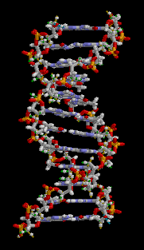
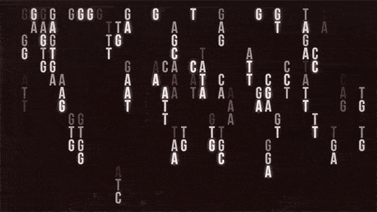
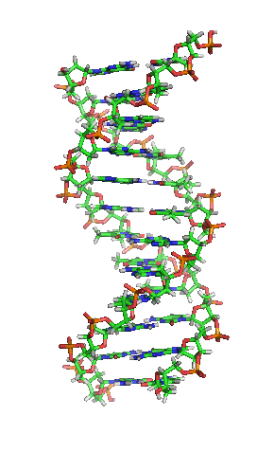
BE A HERO!
Notes:
https://imgur.com/gallery/FOY4UW2

Slide 2
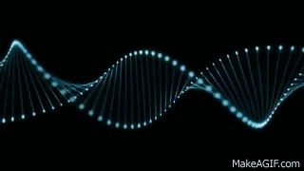
DNA
The carrier of
the genetic information.

Slide 3
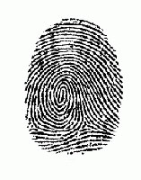
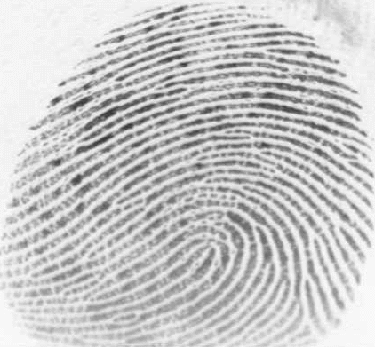
You can tell people apart by their fingerprints because everyone’s are a little bit different…
DNA is like a fingerprint because everyone’s is a little different!

Slide 4
DNA
A thread-like chain of nucleotides carrying the genetic instructions for:
growth
development
cell function and
reproduction

Slide 5
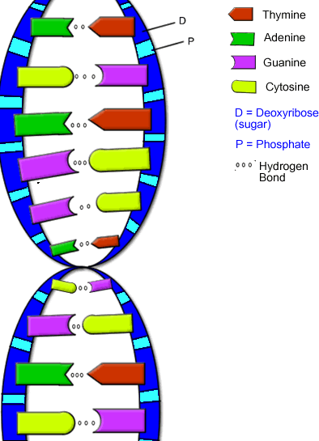
DNA is made up of steps and rails like a ladder.
This is a rail/side
This is a step/rung
Green can only go with Red
Purple can only go with Yellow

Slide 6
NUCLEOTIDE
The two DNA strands are called polynucleotides. They are composed of simpler monomer units called nucleotides.

Slide 7
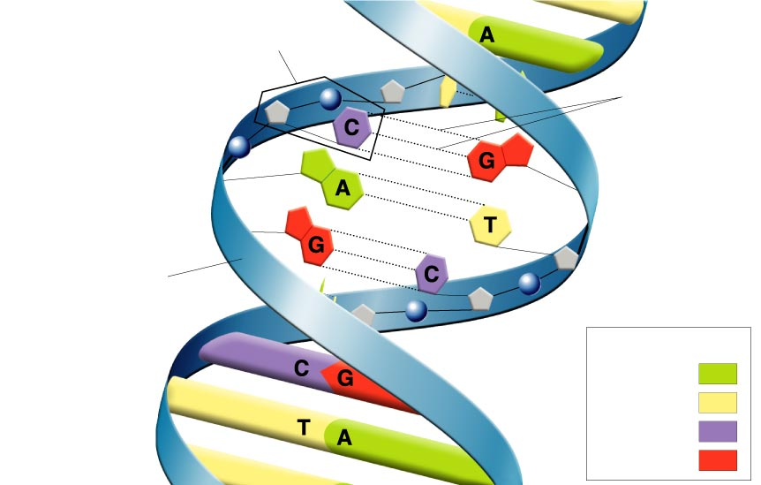
DNA Structure:
organic polymer made up of repeating nucleotides
Nucleotide
H bonds
Sugar-phosphate
backbone
Nitrogen Bases
A
T
C
G

Slide 8
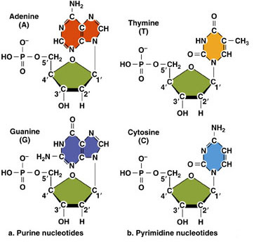
Building blocks of DNA: Nucleotides

Slide 9
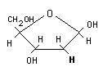
The sugar = Deoxyribose
BACKBONE
Shape = pentose
The phosphate

Slide 10
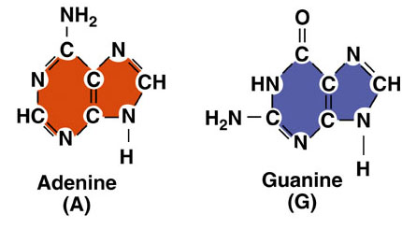
The nitrogenous bases
Purines

Slide 11
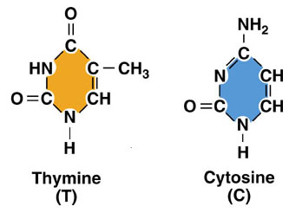
The nitrogenous bases
STEPS/RUNGS
Pyrimidines
How are the pyrimidines different from the purines?

Slide 12
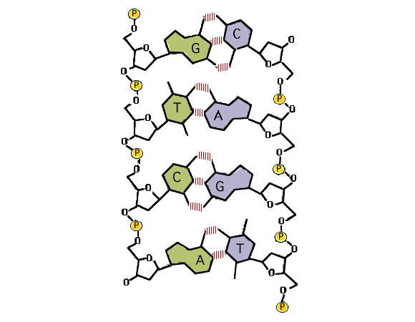
DNA is a polymer formed by base pairing: Base pairing rule
A pairs with T
C pairs with G

Slide 13
https://www.youtube.com/watch?v=qNliacSzFks&t=1615s
How was DNA discovered?
Notes:
https://www.youtube.com/watch?v=qNliacSzFks&t=88s

Slide 14
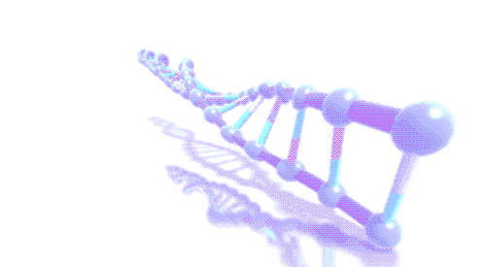
Nuclein
Dr. Miescher in 1869 was the first researcher to isolate nucleic acids.
He isolated various phosphate-rich chemicals and named them as nuclein (now nucleic acids).

Slide 15
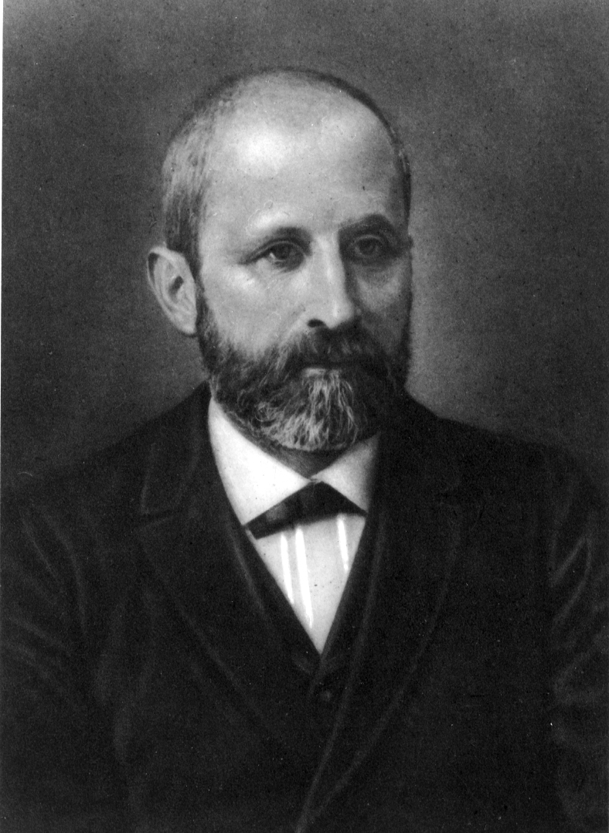
Johannes Friedrich Miescher (13 August 1844 – 26 August 1895)

Slide 16
Miescher came from a scientific family. His father and his uncle held the chair of anatomy at the University of Basel.
In the summer of 1865 Friedrich became ill with typhoid fever, which left him hearing-impaired. However, he still received his MD in 1868.

Slide 17
Because of his partial deafness, he turned to physiological chemistry.
He would collect bandages from nearby hospital and wash neutrophils without damaging them.

Slide 18
He was able to isolate nuclei free of cytoplasm.
He was able to precipitate nuclei and found that they are made up of N₂ and P. He named them as nuclein.
We now call it as nucleic acid or DNA.

Slide 19
Why do you need DNA for?

Slide 20
http://www.foodandwine.com/news/home-dna-test-can-determine-your-food-sensitivities
https://www.everlywell.com/products/food-sensitivity/

Slide 21
At-Home DNA Test Can Determine Your Food Sensitivities
Have you ever wondered whether you can eat gluten, for example, or if the belly bloat you experience after noshing on cheese is all in your head or a really bad reaction in your body, the test might be for you.

Slide 22
Helix-partnered food sensitivity test
Using the blood sample you provide, EverlyWell measures your immune response to 96 foods.
A scale of zero to three
0=Good to eat
3=Bad Reaction
Notes:
http://www.foodandwine.com/news/home-dna-test-can-determine-your-food-sensitivities

Slide 23
DNA fingerprinting
DNA fingerprinting is a method used to identify an individual from a sample of DNA by looking at unique patterns in their DNA.

Slide 24
GENE THERAPY
Gene therapy is an experimental technique that uses genes to treat or prevent disease. In the future, this technique may allow doctors to treat a disorder by inserting a gene into a patient’s cells instead of using drugs or surgery.

Slide 25
Recombinant DNA Technology
Human Insulin and Human Growth Hormone

Slide 26
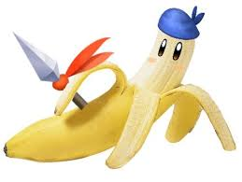
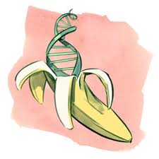
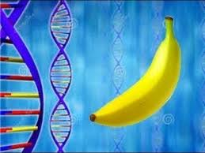
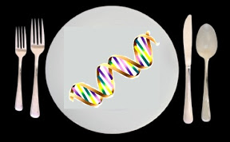

Isolation of DNA from strawberries, bananas, or cheek cells.

Slide 27
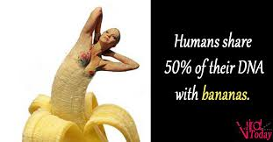
AM I RIGHT?

Slide 28
https://www.youtube.com/watch?v=M4zHVRLXkgw&t=5s
https://www.youtube.com/watch?v=B_PQ8qYtUL0&t=1s
1.What is the blueprint of life?
2.What is the major function of DNA?

Slide 29
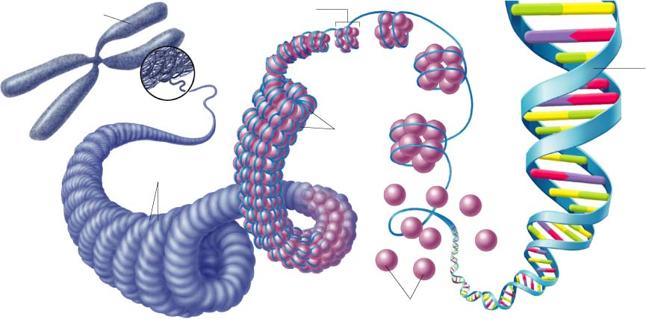
DNA is packed tightly in the cell
Learning Target: Describe the structure of a
DNA molecule
CHROMOSOME
DNA double
helix
Supercoils
HISTONES

Slide 30
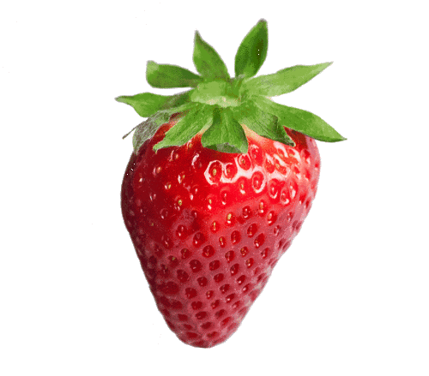
DNA isolation from strawberries
1 strawberry
10 ml extraction buffer
15 ml ice cold ethanol or hand sanitizer
Half cup hot water, a teaspoon salt, teaspoon dish detergent.

Slide 31
FINISH THE WORKSHEET

Slide 32
GENOMICS
Study of the genome
or all the genes in an
Organism.

Slide 33
BIOINFORMATICS
Convergence of biology and computer science to store, retrieve, and analyze data.

Slide 34
BIOINFORMATICS
Sometimes called computational molecular biology.

Slide 35
BIOINFORMATICS
Sequence
Structural
Functional analysis of genes and genomes and their corresponding products.

Slide 36
BIOINFORMATICS
Nucleotide sequences
Protein sequences
Biology
Computer science
Mathematics mainly algorithms
Statistics

Slide 37
BIOINFORMATICS
Main goal is to figure out what biological data means?
Housing or storing data is important.
GenBank is currently housing over twenty-two billion sequence records.

Slide 38
Pharmacogenomics
Allows scientists to use bioinformatics to design and prescribe personal medications to individuals

Slide 39
NCBI
Notes:
t Google and other search engines typically do not index database-driven websites,

Slide 40
NCBI WEBSITE
Genome and genomic sequences
Gene sequences, mutations
Gene regulation
Gene expression (where and when)
Intron splice variants
Protein sequence, post-translational modifications
Protein tertiary structure (3D)
Protein networks
Protein localization
Enzyme Kinetics
Metabolites, metabolic networks
Diseases
Literature

Slide 41
The first bacterium genome, Haemophilus influenzea, was sequenced in 1995.

Slide 42
Accession code (number)
Each gene and protein has been assigned an accession version number.

Slide 43
BAC16799.1
Notes:
GenPept is a database of GenBank gene products, namely the translation of all CDS (coding sequence) features with a translation qualifier

Slide 44
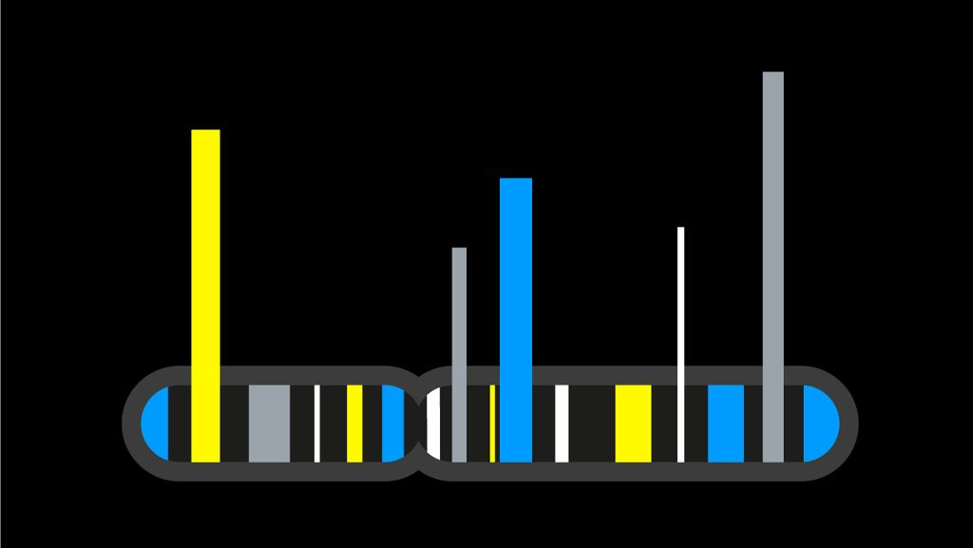
TOP 10 Fasihonable Genes
Through the Years

Slide 45
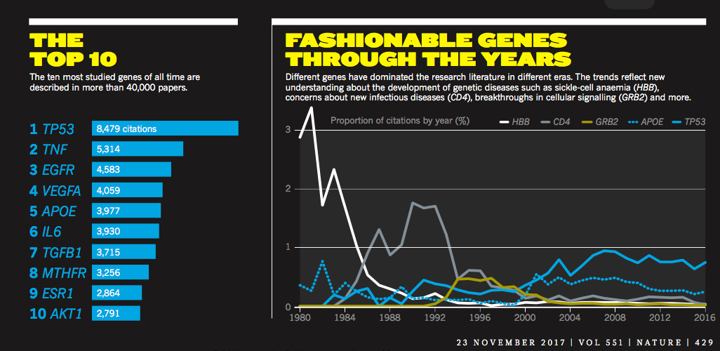

Slide 46
The wet-lab work includes procedures such
as DNA extraction, PCR, and using a computer to
sequence the gene.

Slide 47
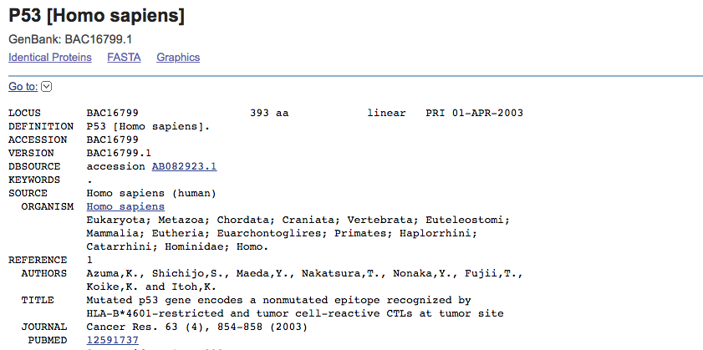
Notes:
195 million 138 thousand 279

Slide 48
^{Use the} ^{chromatogram to determine the} ^{gene sequence.}
Find the closest match.

Slide 49
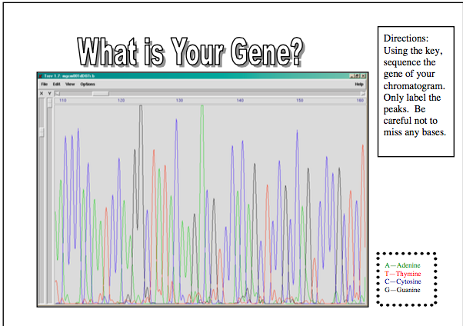

Slide 50
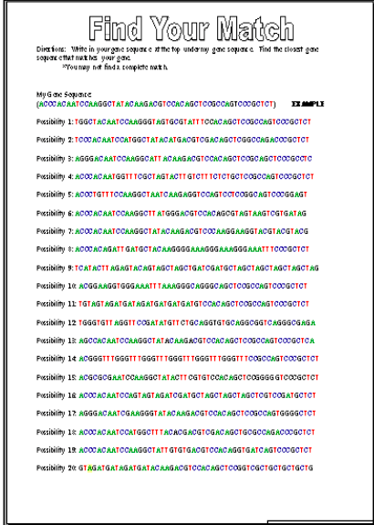

Slide 51
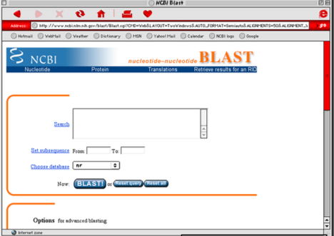

Slide 52
EXIT
1.What common household thing was used to isolate DNA?
2. How can you isolate DNA from other fruits or vegetables?
3. After isolating DNA what do we do with its sequence?
4. What is the common website for finding genomics and proteomics?

Slide 53
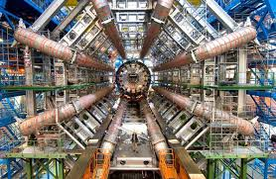
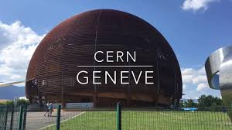
BIOINFORMATICS
The World Wide Web was created
by the CERN institute in Geneva.

Slide 54
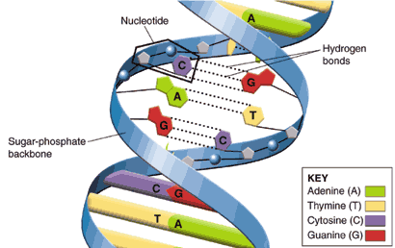
DOUBLE HELIX

Slide 55
DONOW
BE QUIET
Pg.86
10 mins
1.What is DNA?
2.What is a nucleotide?
3.What are four types of nitrogen bases present in DNA?
End

Slide 56
BACKBONE
The nucleotides are joined to one another in a chain by covalent bonds between the sugar of one nucleotide and the phosphate of the next, resulting in an alternating sugar-phosphate backbone.

Slide 57
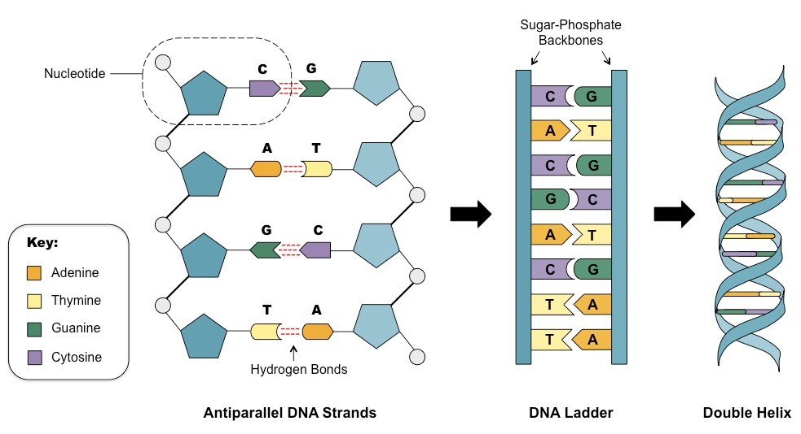

Slide 58
DNA
Each nucleotide is composed of:
A T
C G
Notes:
The nitrogenous bases of the two separate polynucleotide strands are bound together, according to base pairing rules (A with T and C with G), with hydrogen bonds to make double-stranded DNA.

